Slide 1
Computer Architecture: Core and ALU
Dr. Colin O’Flynn

Slide 2
Lectures
How does a program run on a machine?
How do you compile from high-level code to machine code?
How does the machine run? (Control Flow)
How does the machine store, access, and control data?
How does the machine execute instructions?
How is execution made more efficient?
How do we measure execution?

Slide 3
Tie to ISA Lecture
Several of the topics “should” be call-backs to the ISA lecture
In many instances we are going to look in more detail about why choices where made for the ISA here.

Slide 4
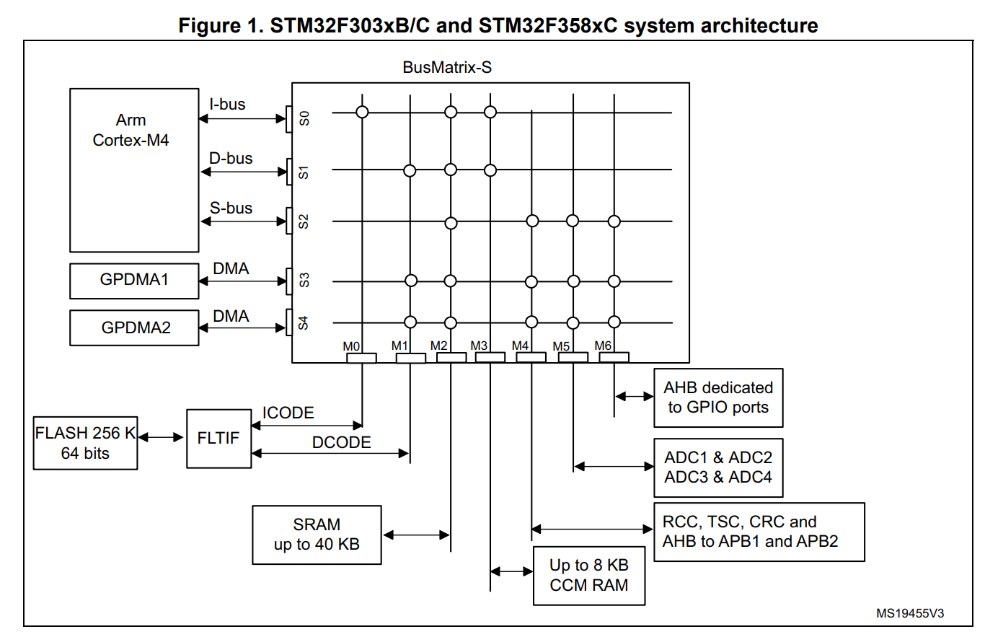
What’s hidden in here?
We now go inside the magic.

Slide 5

Arm vs RISC-V
RISC-V is unique as the Instruction Set Architecture is Open Source.
Other device (such as Arm) have a company behind then – you cannot use the instruction set without paying them $$$.
There are still commercial (closed source) implementations of RISC-V.
But there are also LOTS of open-source processors, simulators, etc.
We can inspect the design of these open-source processors.

Slide 6
Arm vs RISC-V
In the following slides I’ll switch between RISC-V & Arm cores.
They are very similar for these purposes
Most code examples will use Arm assembly

Slide 7
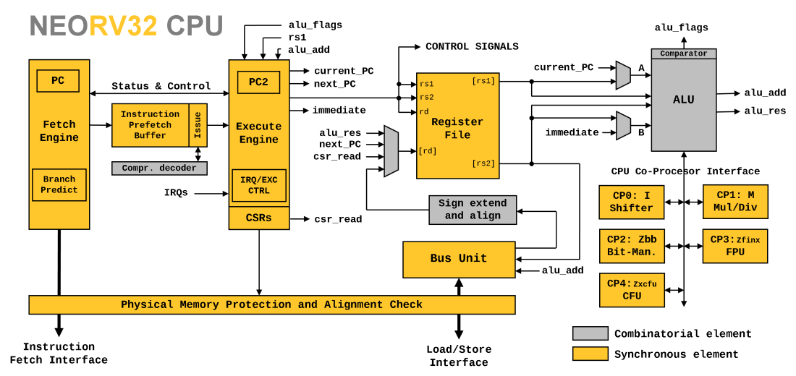

Slide 8
Instruction Lifecycle
Fetch instruction
Decode instruction
Read registers
Execute operation
Access memory (if needed)
Write result

Slide 9
E.g., ADD R1, R2, R3
Fetch E0821003
Decode ADD R1, R2, R3
Read registers
Operand 1 <= R2
Operand 2 <= R3
Execute
Result = R2 + R3
Update flags
5. Access memory (not needed)
Writeback
R1 <= Result

Slide 10
Fetch
Reads data from memory.
May include prefetch buffer of possible instructions (e.g., assume we read next address)
May include issue engine to deal with compressed instructions
https://github.com/stnolting/neorv32/blob/main/rtl/core/neorv32_cpu_frontend.vhd

Slide 11
Decoding
Example of such decoding was in the 2.0 ISA Slides:
Given 32-bits to encode our instructions, we may invent two simple instruction encoding formats for our processor, e.g.:
Instruction Rd, Rs, Operand2
31
25
20
15
10
0
op | rs1 | rs2 | rd | function
op | rs1 | rs2 / rd | immediate
15

Slide 12
Decode
Decoding is normally a simple mapping process of bits to various subsystems.
There is a fine line between fetch and decode – typically before any action is taken we consider this the Frontend
Actual work is done in the Backend:
https://github.com/stnolting/neorv32/blob/main/rtl/core/neorv32_cpu_control.vhd

Slide 13
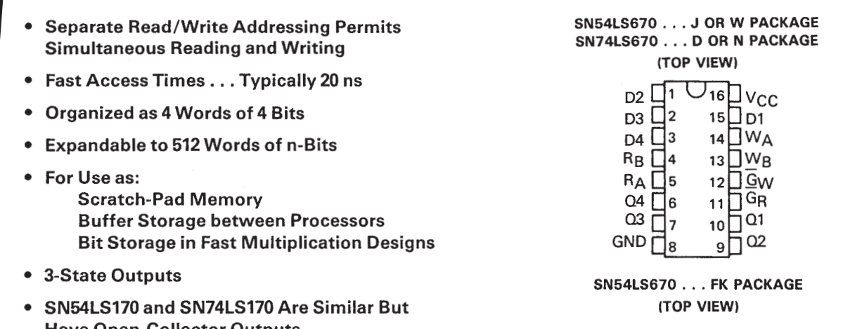
Register File
Registers are very fast memory near CPU
Discussed in ISA lectures

Slide 14
Read Registers

Slide 15
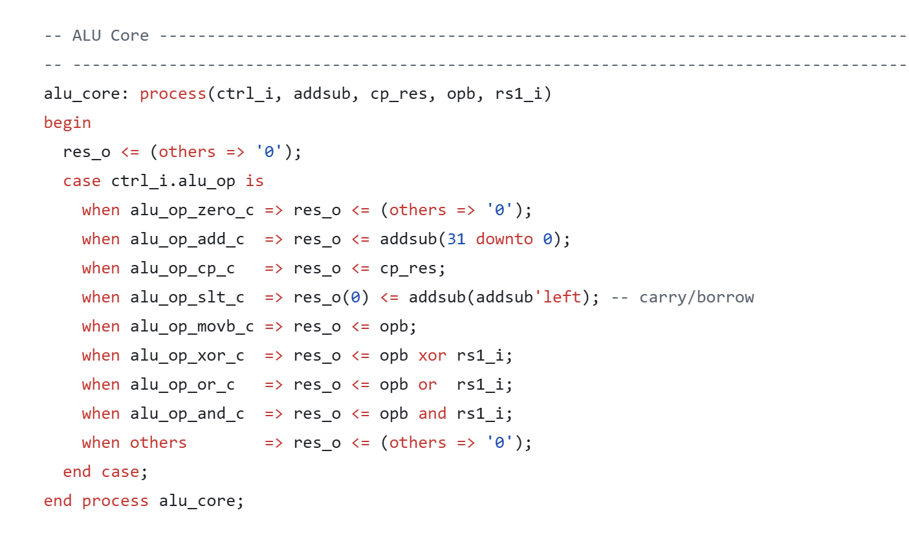
Execute
This is the backend – control (decode) and routing of data to appropriate resource.
Basic operations are actually very simple:
https://github.com/stnolting/neorv32/blob/main/rtl/core/neorv32_cpu_alu.vhd

Slide 16
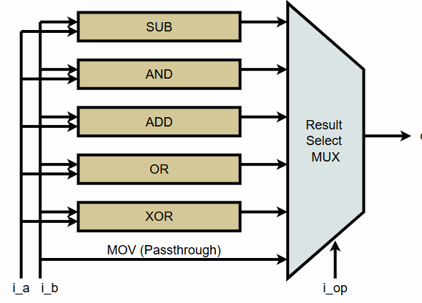
ALU
Combination of simple arithmetic operations & flags
Performs comparisons, arithmetic, bitwise operations
https://zipcpu.com/zipcpu/2017/08/11/simple-alu.html

Slide 17
Status Registers
N = Negative result from ALU
Z = Zero result from ALU
C = ALU operation carry out
V = ALU operation oVerflowed

Slide 18
Carry Flag
Carry flag is normally set as a result of arithmetic operation:
SUB
ADD
Instructions can take the carry as an input:
ADC (Add with Carry)
SBC (Subtract With Carry)

Slide 19
Carry Flag
In Arm specifically:
On addition, carry flag is set if result > 2³² (e.g., overflows unsigned 32-bit)
On subtraction, carry flag is cleared if a borrow occurs
This is opposite some architectures, where carry flag is also a borrow flag (set to 1)
Carry flag also used for compare instructions
CMP = SUB but without a destination (only sets flags)
E.g:
CMP R0, #42 => SUB R0, #42
if R0 == 42:
Zero flag set (can compare if equal)
if R0 < 42:
Carry flag clear (borrow occurred)
If R0 >= 42:
Carry flag set (no borrow)

Slide 20
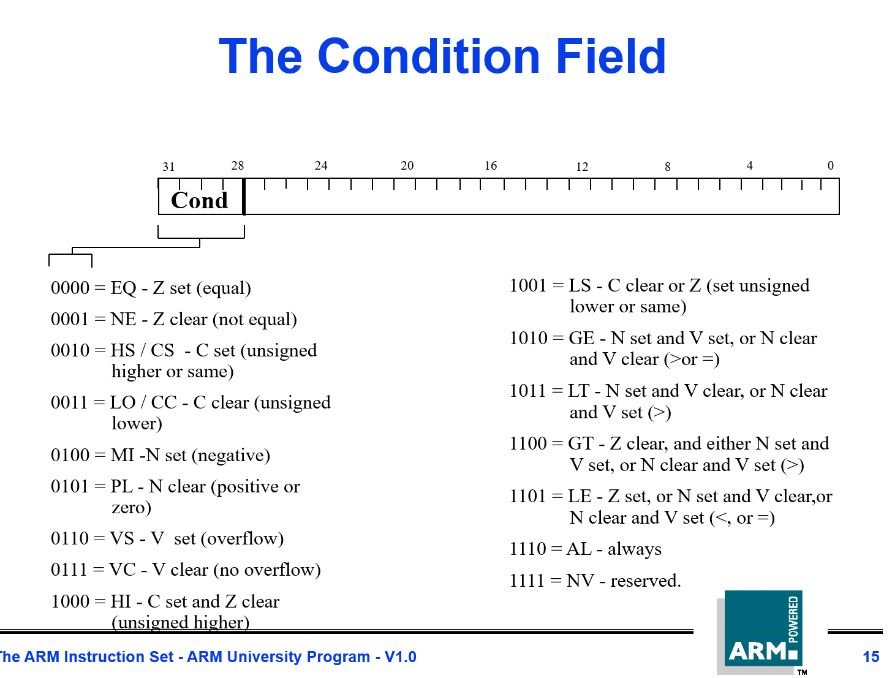
Arm: Control Flow Reminder

Slide 21
Overflow Flag
Overflow flag can be thought of “signed carry”
Remember – sign is using 2’s complement format, where upper bit indicates sign
Set when result of signed operation has opposite sign
e.g., 0x7FFFFFFF = Largest 32-bit signed number possible
0x7FFFFFF + 0x7FFFFFF = 0xFFFFFFFE
Input have sign bit clear
Result does not set carry flag, but does set overflow flag

Slide 22
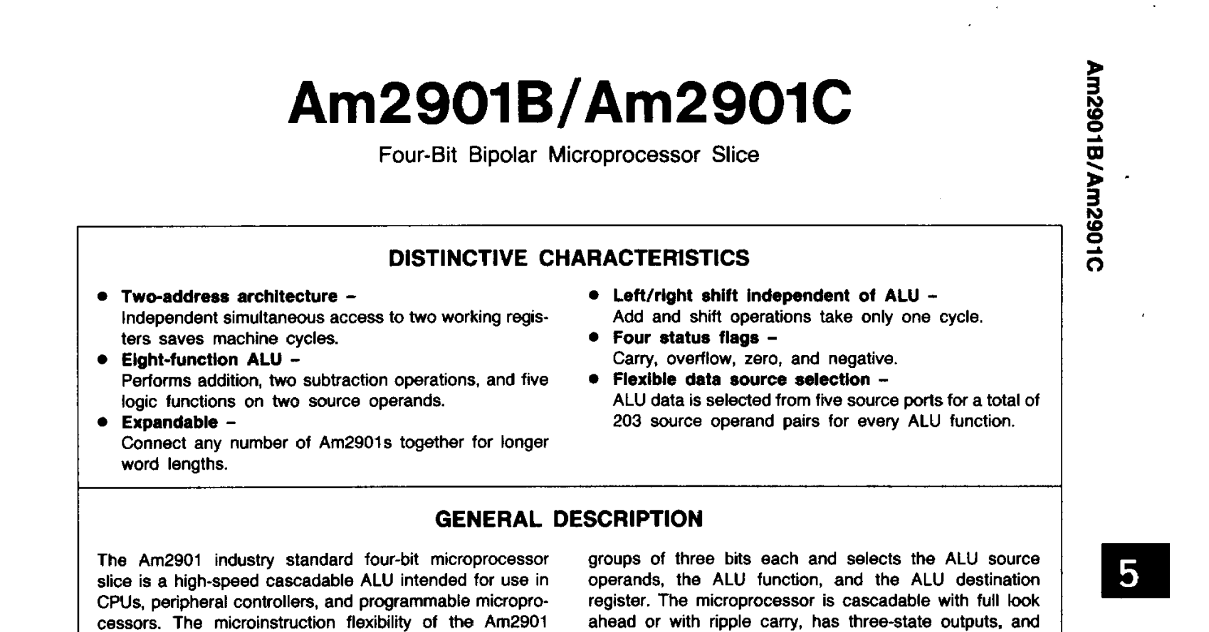
Comparisons to 50 years(!) ago

Slide 23
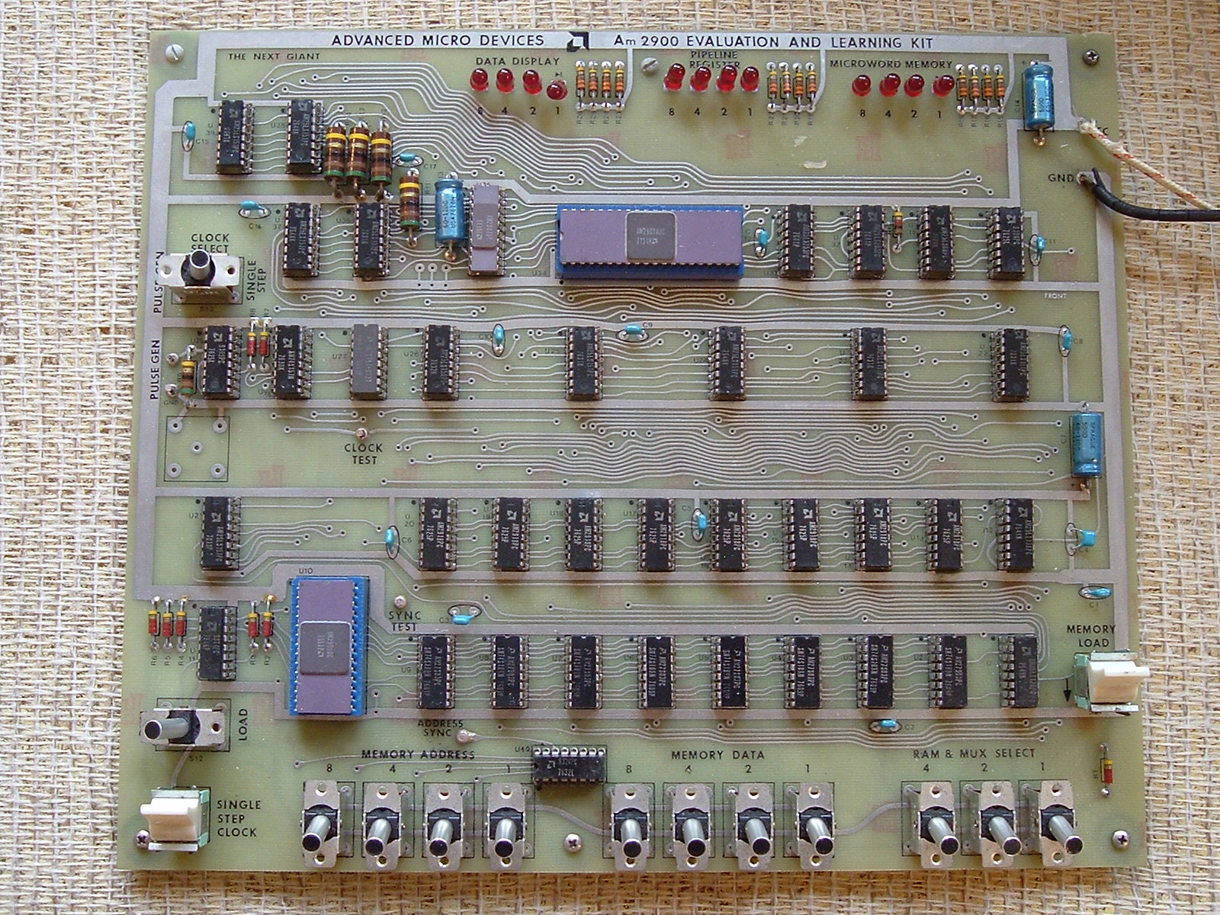

Slide 24
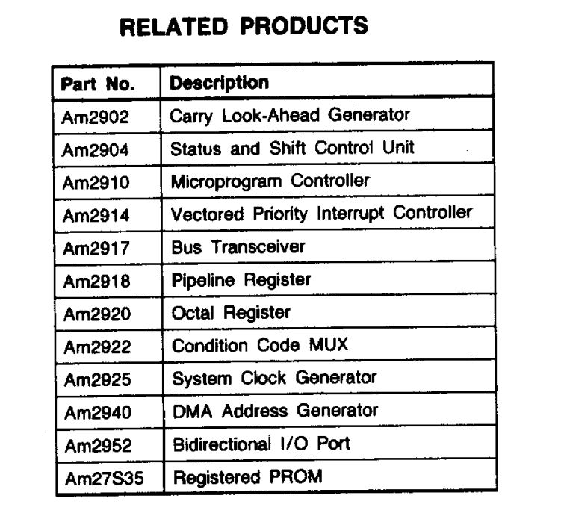

Slide 25
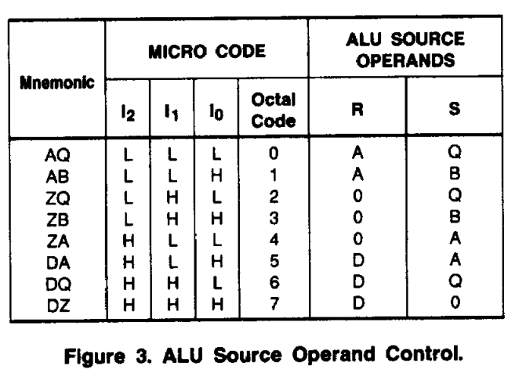
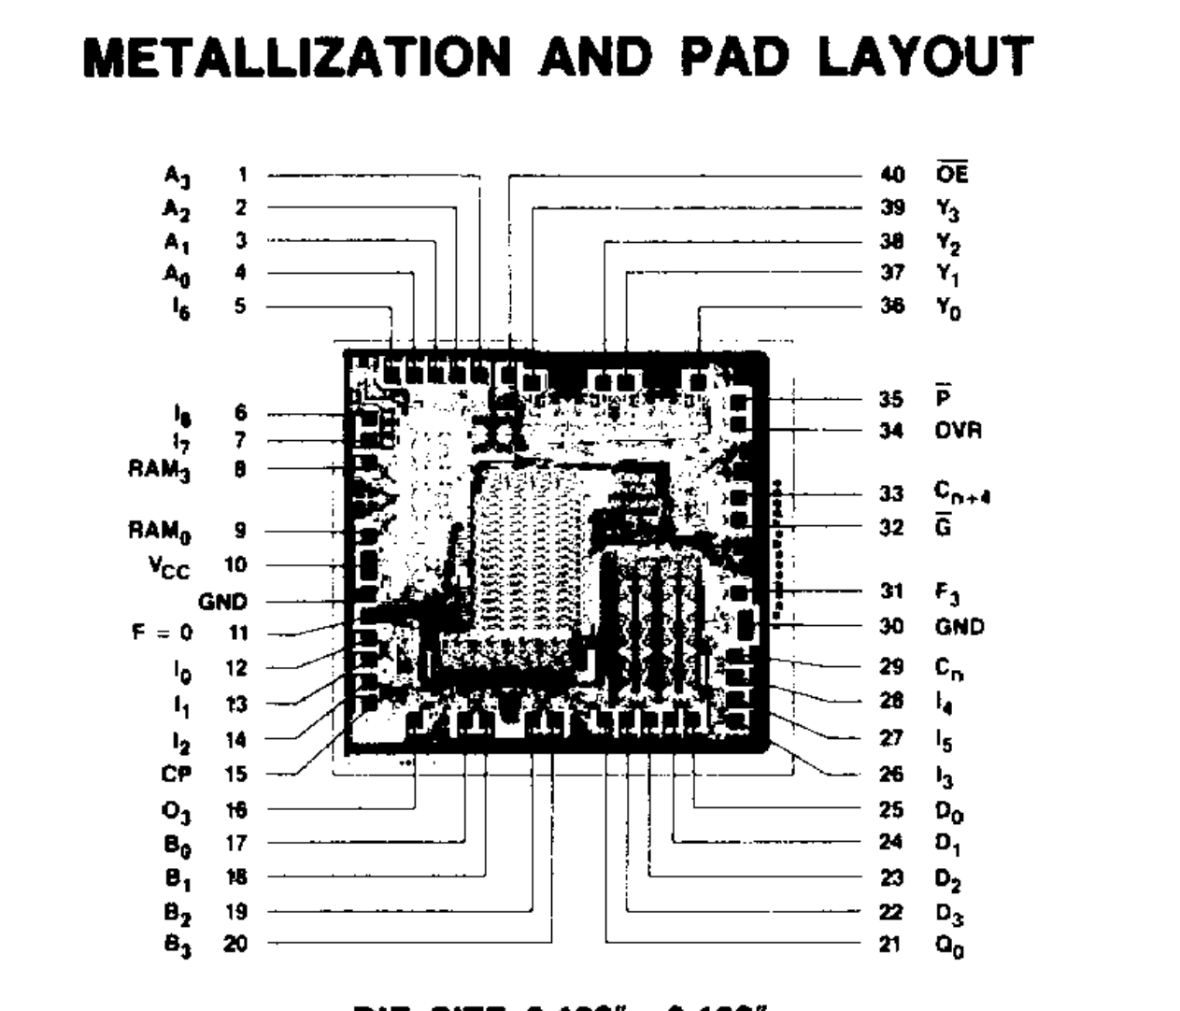
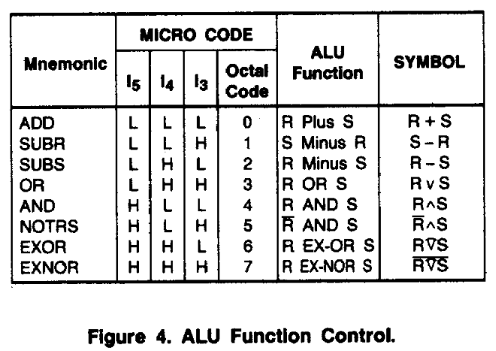

Slide 26
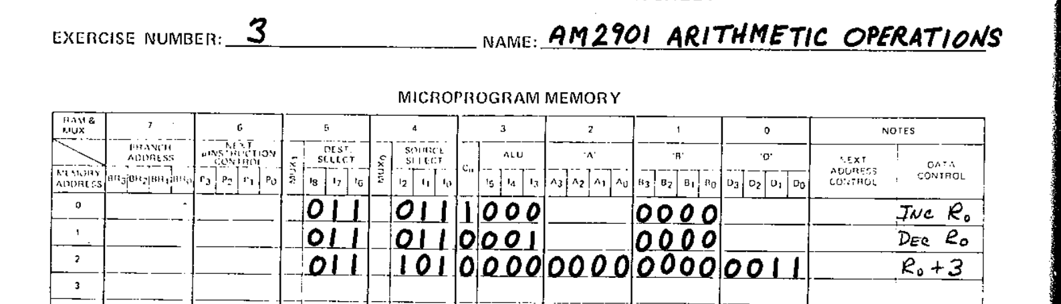
e.g., Simple Increment with AM2901

Slide 27
Memory Access
If memory access is “special” (such as load-store architectures) this may be a separate cycle
Perform any load/store to the memory system, not just register access

Slide 28
Write Back
Output registers are updated
(This is often part of another stage)

Slide 29
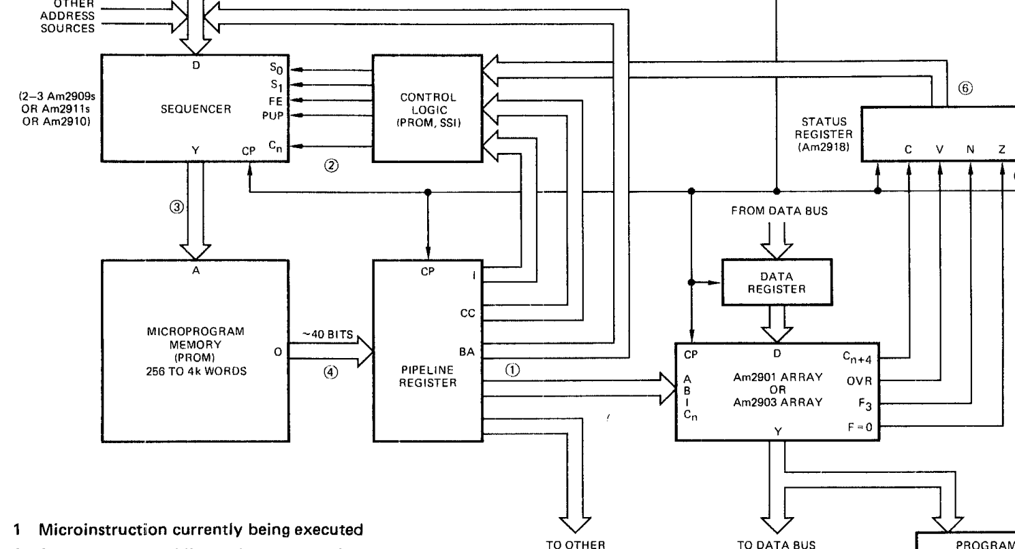
Microprogram Instructions
Even our 50 year old CPU had the idea of microcode or microprogram
Instructions implemented from ALU operations

Slide 30
Superscalar Processors
Before multi-core processors were popular, we had the idea of superscalar
Allows execution of simultaneous instructions – often duplicating some resources (ALU)
ldr r0, #35
add r2, r3, r4
add r0, r3
add r3, r5

Slide 31
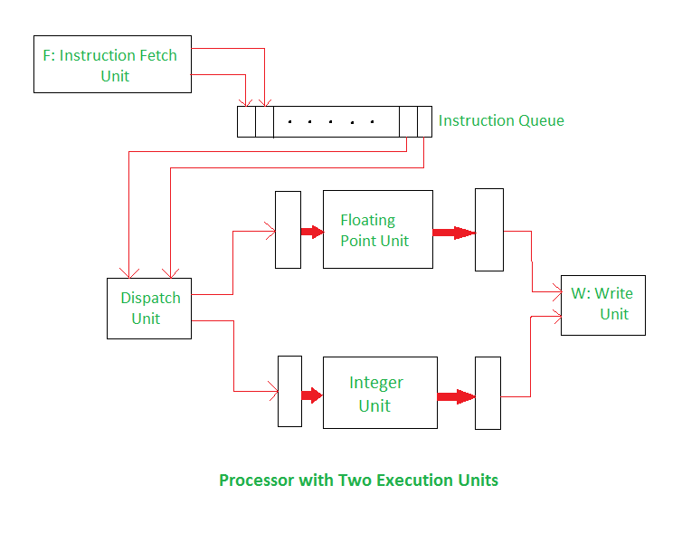
Superscalar: Different Execution Units (ALU)
https://www.geeksforgeeks.org/computer-organization-architecture/superscalar-architecture/

Slide 32
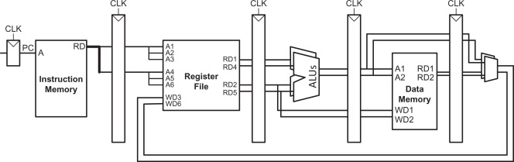
Superscalar: Multiple of Same Execution Unit (ALU)

Slide 33
Instruction & ALU Summary
Instructions are executed in several stages, some of these may be “combined”:
Fetch instruction
Decode instruction
Read registers
Execute operation
Access memory (if needed)
Writeback
Status register flags are an import part of the ALU usage
Microcode-based instructions are a common feature (that may be “hidden” from you)

